Slide 1
Pokémon Image Recognition
CS 5232 - Machine Learning and Data Mining
Group 3: Eric Nieters, Ritwik Raj Saxena, and Ibrahim Mamudu
1.Transfer Learning with Pretrained Models (CNN as Pretrained Model as well as New Classifier) performed the best on both metrics, computation time and accuracy.
2.CNNs faired very similar to Transfer Learning on the metric of accuracy, but took longer computation times.
3.SVM and K-NN took immensely long to execute as well as provided much poorer performance compared to the Transfer Learning and CNN models because they are not suited for image recognition. They are not good at processing image data, especially large tensors.
4.The performance of SVM shows that it is much less suited to large datasets with a large number of classes compared to the other three algorithms.

Slide 2
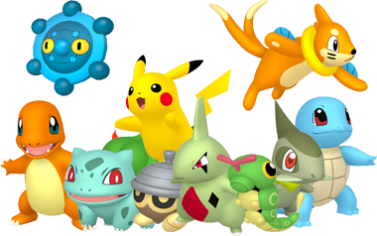
Outline
Introduction
Proposed Work
Implementations of algorithms
Datasets
Code Overview
Live Demo
Results
Conclusion
Source: https://pokecoord.com/pokemon-nests/

Slide 3
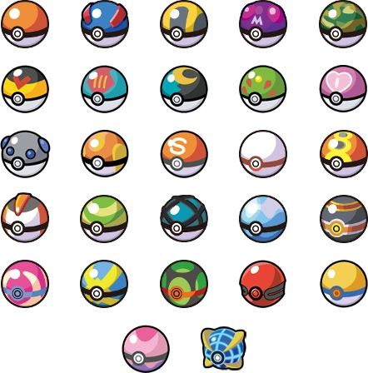
Introduction
The Problem:
Pokémon image recognition is uncommon.
Existing models detect Pokémon, but provide no other information.
Most programs recognize few Pokémon.
The Solution:
Implement a website for detecting Pokémon.
Provides easier access than software.
Detect ⅔ of all currently existing Pokémon.
Source: https://nintendo.fandom.com/wiki/Poké_Ball
Notes:
Motivation: No popular machine learning based model exists for pokemon image classification
Hypothesis: Machine learning algorithms will help us classify and predict pokemon based on image input

Slide 4
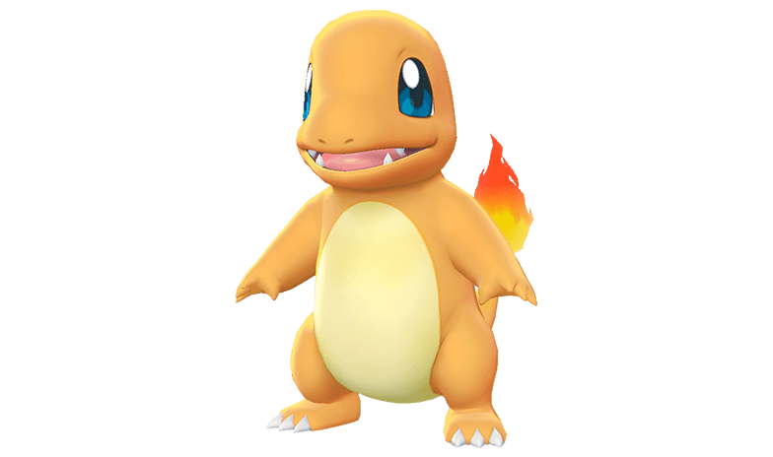
Introduction (Part 2)
Our algorithms (most accurate to least accurate):
Convolutional Neural Networks
Pre-trained Models
Support Vector Machines
K-Nearest Neighbor
Other Features:
Website implementation
Compare your image to the predicted Pokémon
Display stats of the predicted Pokémon
Analyze all of the stats of the predicted Pokémon
Source: https://projectpokemon.org/home/gallery/image/78446-charmanderpng/

Slide 5
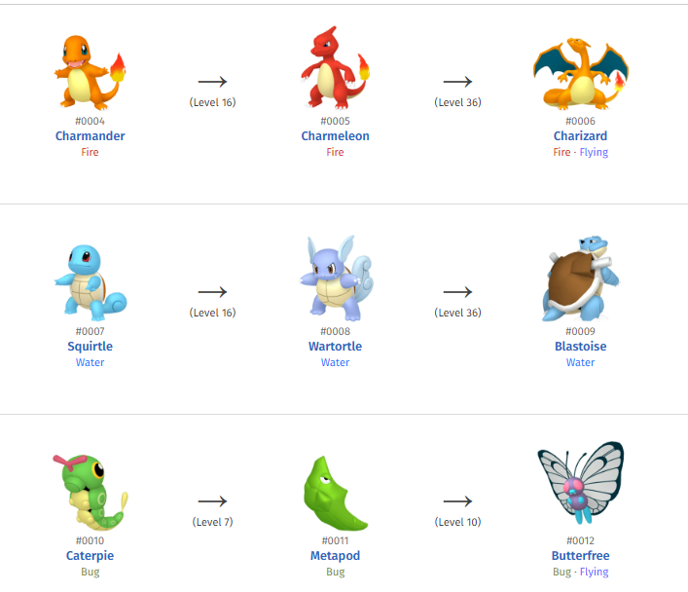
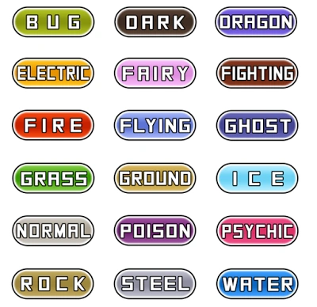
An Introduction to Pokemon
A pokemon is a fictional creature which is the basis for certain Japanese and Japan-inspired games and cartoons. It has stats, a type, a generation, and an evolution paradigm, as shown in the figure on the right. A list of the categories under which a pokemon can fall is as under:

Slide 6
Proposed Work
Supervised learning was used to train models.
Read in 10-20 images of each of 721 Pokémon.
Collect data, such as patterns, colors, number of pixels or size, depending on the model.
Store the model’s data and load it whenever a prediction is being made.
Developed in Python. Website uses PHP, HTML, CSS, JavaScript, jQuery, and the Bootstrap framework.
All models are pre-trained. This reduces website load.
Notes:
●A user who goes by the handle Code AI gives a step-by-step description of how they used CNN for Pokémon image recognition on Medium.
●Chirra et al, in their recent research paper have used transfer learning to classify Pokémon images. They have created an index of Pokémon which they term Pokepedia. Their ResNet101 pre-trained model gave the best accuracy when measured against the rest of their models.
●Chu et al. presented their work ‘Attribute Prediction in Pokémon Images using CNNs’ at the 2nd International Conference on Electrical Engineering, Big Data and Algorithms (EEBDA) in China [6]. Their algorithm can determine the number of Pokémon belonging to a specific type (fire, water, grass, bug etc.) in their dataset consisting of images of 802 Pokémon. They utilized the images of the Pokémon obtained from a scorching game branded as Pokémon as their dataset [6]. However, their algorithm cannot determine any other statistic of a Pokémon, including the generation or even the name. This gives it serious limitations compared to the work that we propose.

Slide 7
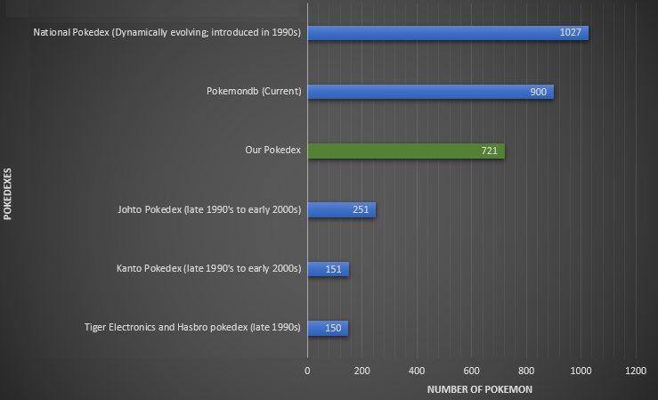
Comparison of Pokédexes

Slide 8
Convolutional Neural Networks (CNN)
Each layer performs convolutions on images.
Convolutions enable the architecture to extract features from each image exhaustively.
CNNs are usually deep to very deep architectures, depending on the number of convolution operations involved. Usually higher the number of convolutions, better is the feature extraction, and better is the prediction power of the model.
They are usually used as the pretrained models as well as the new classifiers in a Transfer Learning setup for object or image classification.

Slide 9

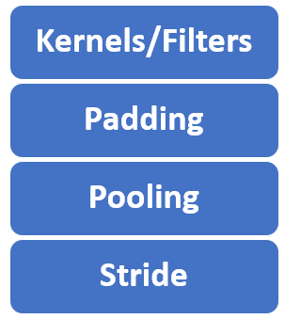
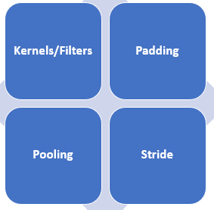
Distinctive Features of Convolutional Neural Networks (CNN)
Notes:
In image processing, a kernel, convolution matrix, filter, or mask is a small matrix used for blurring, sharpening, embossing, edge detection, and more. This is accomplished by doing a convolution between the kernel and an image. Or more simply, when each pixel in the output image is a function of the nearby pixels (including itself) in the input image, the kernel is that function.
Padding is a critical technique used to manage the spatial dimensions of input data. Padding is the process of adding layers of zeros or other values outside the actual data in an input matrix. The primary purpose of padding is to preserve the spatial size of the input so that the output after applying filters (kernels) remains the same size, or to adjust it according to the desired output dimensions.
Output feature maps are sensitive to the location of the features in the input. One approach to address this sensitivity is to downsample the feature maps. This has the effect of making the resulting downsampled feature maps more robust to changes in the position of the feature in the image, referred to by the technical phrase “local translation invariance.”
Pooling layers provide an approach to down sampling feature maps by summarizing the presence of features in patches of the feature map. Two common pooling methods are average pooling and max pooling that summarize the average presence of a feature and the most activated presence of a feature respectively.
Stride is a parameter that dictates the movement of the kernel, or filter, across the input data, such as an image. When performing a convolution operation, the stride determines how many units the filter shifts at each step. This shift can be horizontal, vertical, or both, depending on the stride's configuration.
For example, a stride of 1 moves the filter one pixel at a time, while a stride of 2 moves it two pixels. A larger stride will produce a smaller output dimension, effectively downsampling the image.

Slide 10
We used Convolutional Neural Networks for image classification because
Pattern identification: They were created specifically for image classification; they efficiently recognize patterns from the images.
Color recognition: They focus on efficacious color recognition and different color planes
Critical feature isolation: They minutely track extremely critical features, like edges, on each image to produce an immensely precise prediction.

Slide 11
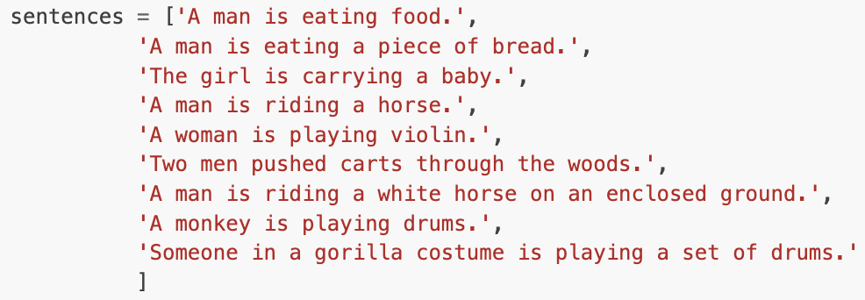
Transfer Learning with Pre-Trained Models
Our transfer learning utilizes the library called SentenceTransformers
A library for sentence, text and image embeddings.
Similar to “implementing Google” using your own detected vocabulary.
Works with multiple languages.
Detects over 1,000,000,000+ pairs by using a 256 dimension vector field that can plot images and sentences near each other.
K-Nearest Neighbor on steroids.
Can detect the top five most similar pairs of sentences:

Slide 12

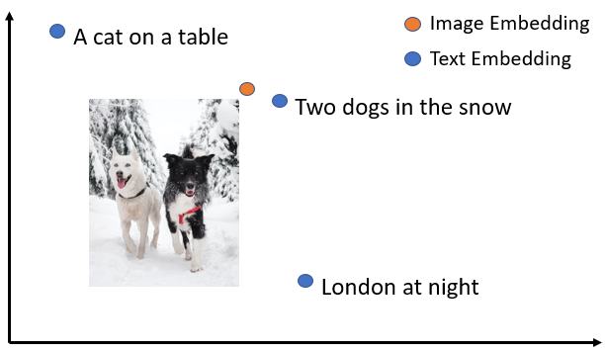
Source: https://www.sbert.net/examples/applications/image-search/README.html

Slide 13

K-Nearest Neighbor
Our “from scratch” algorithm which uses no machine learning libraries.
All images of Pokémon get converted into an array that counts the number of times that 256 total colors appear in each image.
Euclidean Distance is measured between the tested Pokémon and every single Pokémon image in the dataset.
The “shortest” distance between the trained set and the tested Pokémon is stored in ranking order.
The most difficult algorithm to implement for our project!
Source: https://pngimg.com/image/27696

Slide 14

Support Vector Machines (SVM)
SVMs aim to find the optimal hyperplane to separate different classes while maximizing the margin between the closest data points (support vectors).
Not very well suited to image recognition, but work well for smaller datasets and “plottable” data.
Was still utilized in the experiment to show the which algorithms must and must not be used for image detection.
Accuracy was difficult to improve upon, as well as computation time.
The least recommended algorithm for a project like this.
Source: https://www.stickpng.com/img/games/pokemon/bulbasaur-pokemon

Slide 15
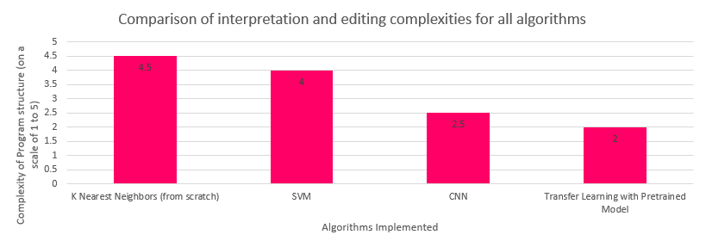
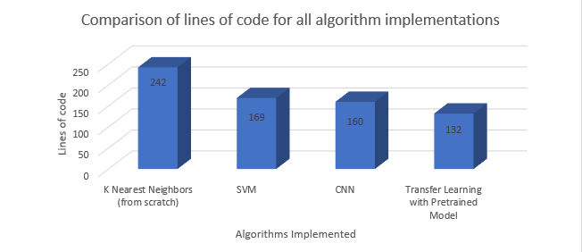
Comparison of Intricacy of our Algorithms
Notes:
We were intending to implement Precision, Recall, F1 Metric and to calculate the area under Receiver Operating Curve for our algorithms for the generation of more statistics and plots, but the decision was taken after the algorithms had been implemented. The high complexity of some and the constraints of not using machine learning libraries with at least one of the programs hampered our goal to implement those metrics.

Slide 16
Datasets
Image data:
Generated by us.
Originally contained 14,420 images.
4,347 images removed by hand that were bad data, leaving 10,073 images in our final dataset.
The images that were removed had detailed background, props, multiple Pokémon in one image, etc.
Used BingImageDownloader in Python.
Pokémon statistical data:
Generated by alopez247 on Kaggle.
Contains 721 Pokémon from generations 1 through 6.
Each entity has 21 attributes.
Details range from stats from the games to the type of egg that it’s hatched from.
21 years worth of information.
All displayed on the website.
Source: https://www.kaggle.com/datasets/alopez247/pokemon

Slide 17

Code Overview (CNN)
InceptionResNetV2 was used from the Keras/Tensorflow Python library.
A pretrained model trained on Imagenet dataset.
Uses the Inception family of architectures, created by Google.
Integrates Inception model with the idea of residual connections (ResNet).
Described as a very deep architecture.
Was developed with the aim to enhance algorithmic performance, primarily in image detection, classification, processing and prediction.
Notes:
Model Compilation:
optimizer: Adam optimizer with a learning rate of 0.0001.
loss: Categorical cross-entropy loss function for multi-class classification.
metrics: Accuracy metric to monitor during training.
Training:
epochs: Number of training epochs has been set to 10.

Slide 18
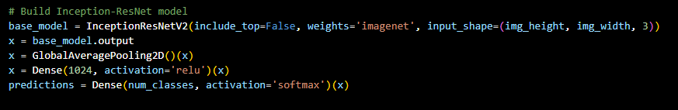
Our InceptionResNetV2 Model uses four layers:
InceptionResNetV2 Base Model:
InceptionResNetV2 is a deep CNN architecture combining the Inception architecture with residual connections.
This first line of the code creates the base model using InceptionResNetV2 with the following settings:
include_top=False: Excludes the fully connected layers at the top of the network, allowing for custom additional layers.
weights='imagenet': Initializes the model with weights pre-trained on the ImageNet dataset.
Global Average Pooling Layer: GlobalAveragePooling2D() layer reduces each feature map to a single value by averaging all values in the feature map, providing a fixed-size output.
Dense Layer (with ReLU Activation):
Dense(1024, activation='relu'): Adds a fully connected layer with 1024 units and ReLU activation function.
This layer performs a linear transformation on the incoming data followed by an element-wise ReLU activation function.
It introduces non-linearity (through ReLU) to the network and helps learn complex patterns in the data.
Output Dense Layer (with Softmax Activation):
Dense(num_classes, activation='softmax'): Adds the final dense layer with num_classes units (representing the number of classes in the classification task) and a softmax activation function.
Softmax activation calculates class probabilities for multi-class classification.
Notes:
InceptionResNetV2 comprises various blocks, including convolutional layers, residual blocks, and Inception modules. The number of layers excluded when setting include_top=False will generally consist of the dense layers responsible for classification, typically a global average pooling layer followed by fully connected dense layers. We dropped these and added our own Global Average Pooling Layer and Dense Layer with ReLU architecture. This GlobalAveragePooling2D() layer performs global average pooling over the spatial dimensions of the input tensor.

Slide 19
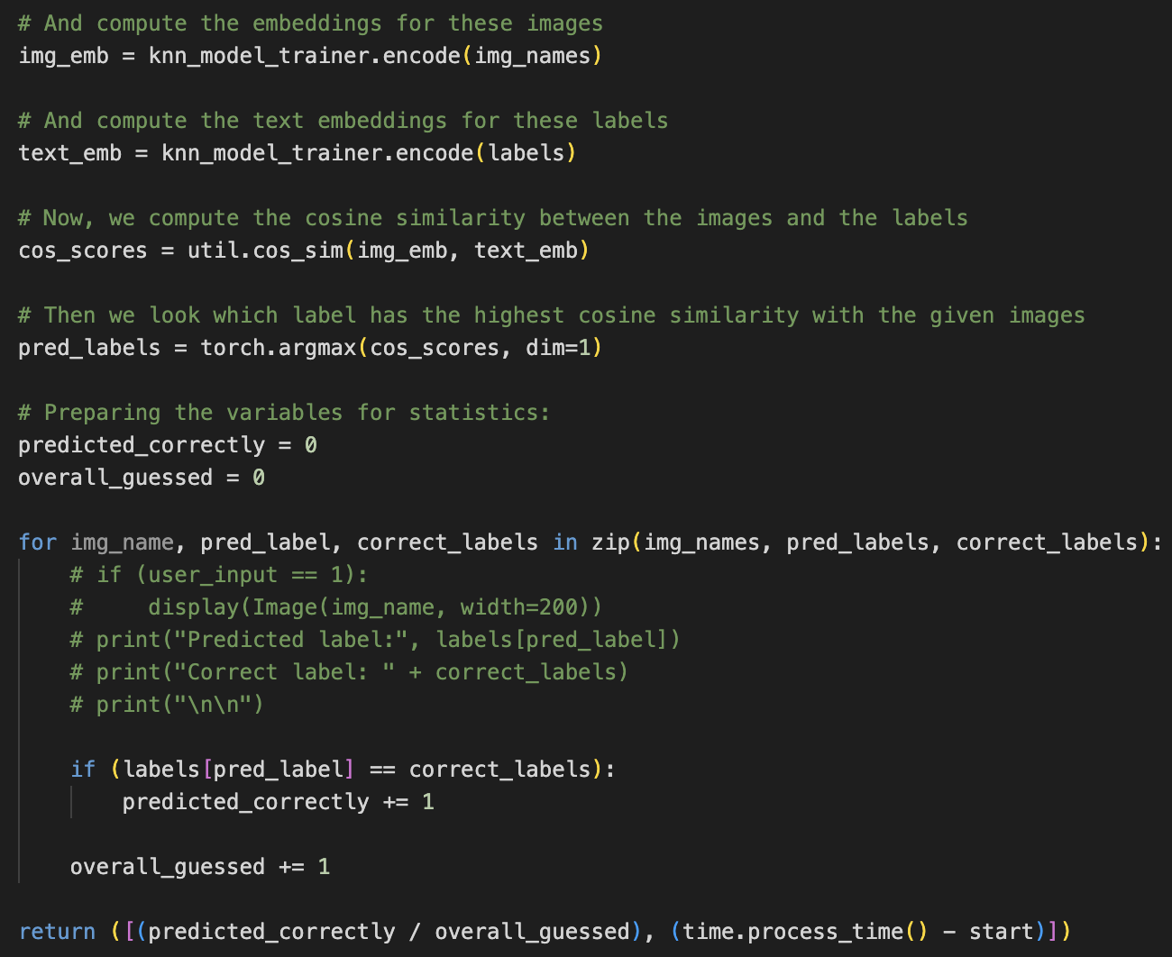
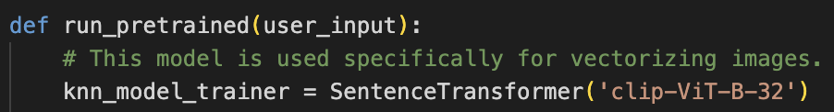
Code Overview (Pre-Trained)

Slide 20
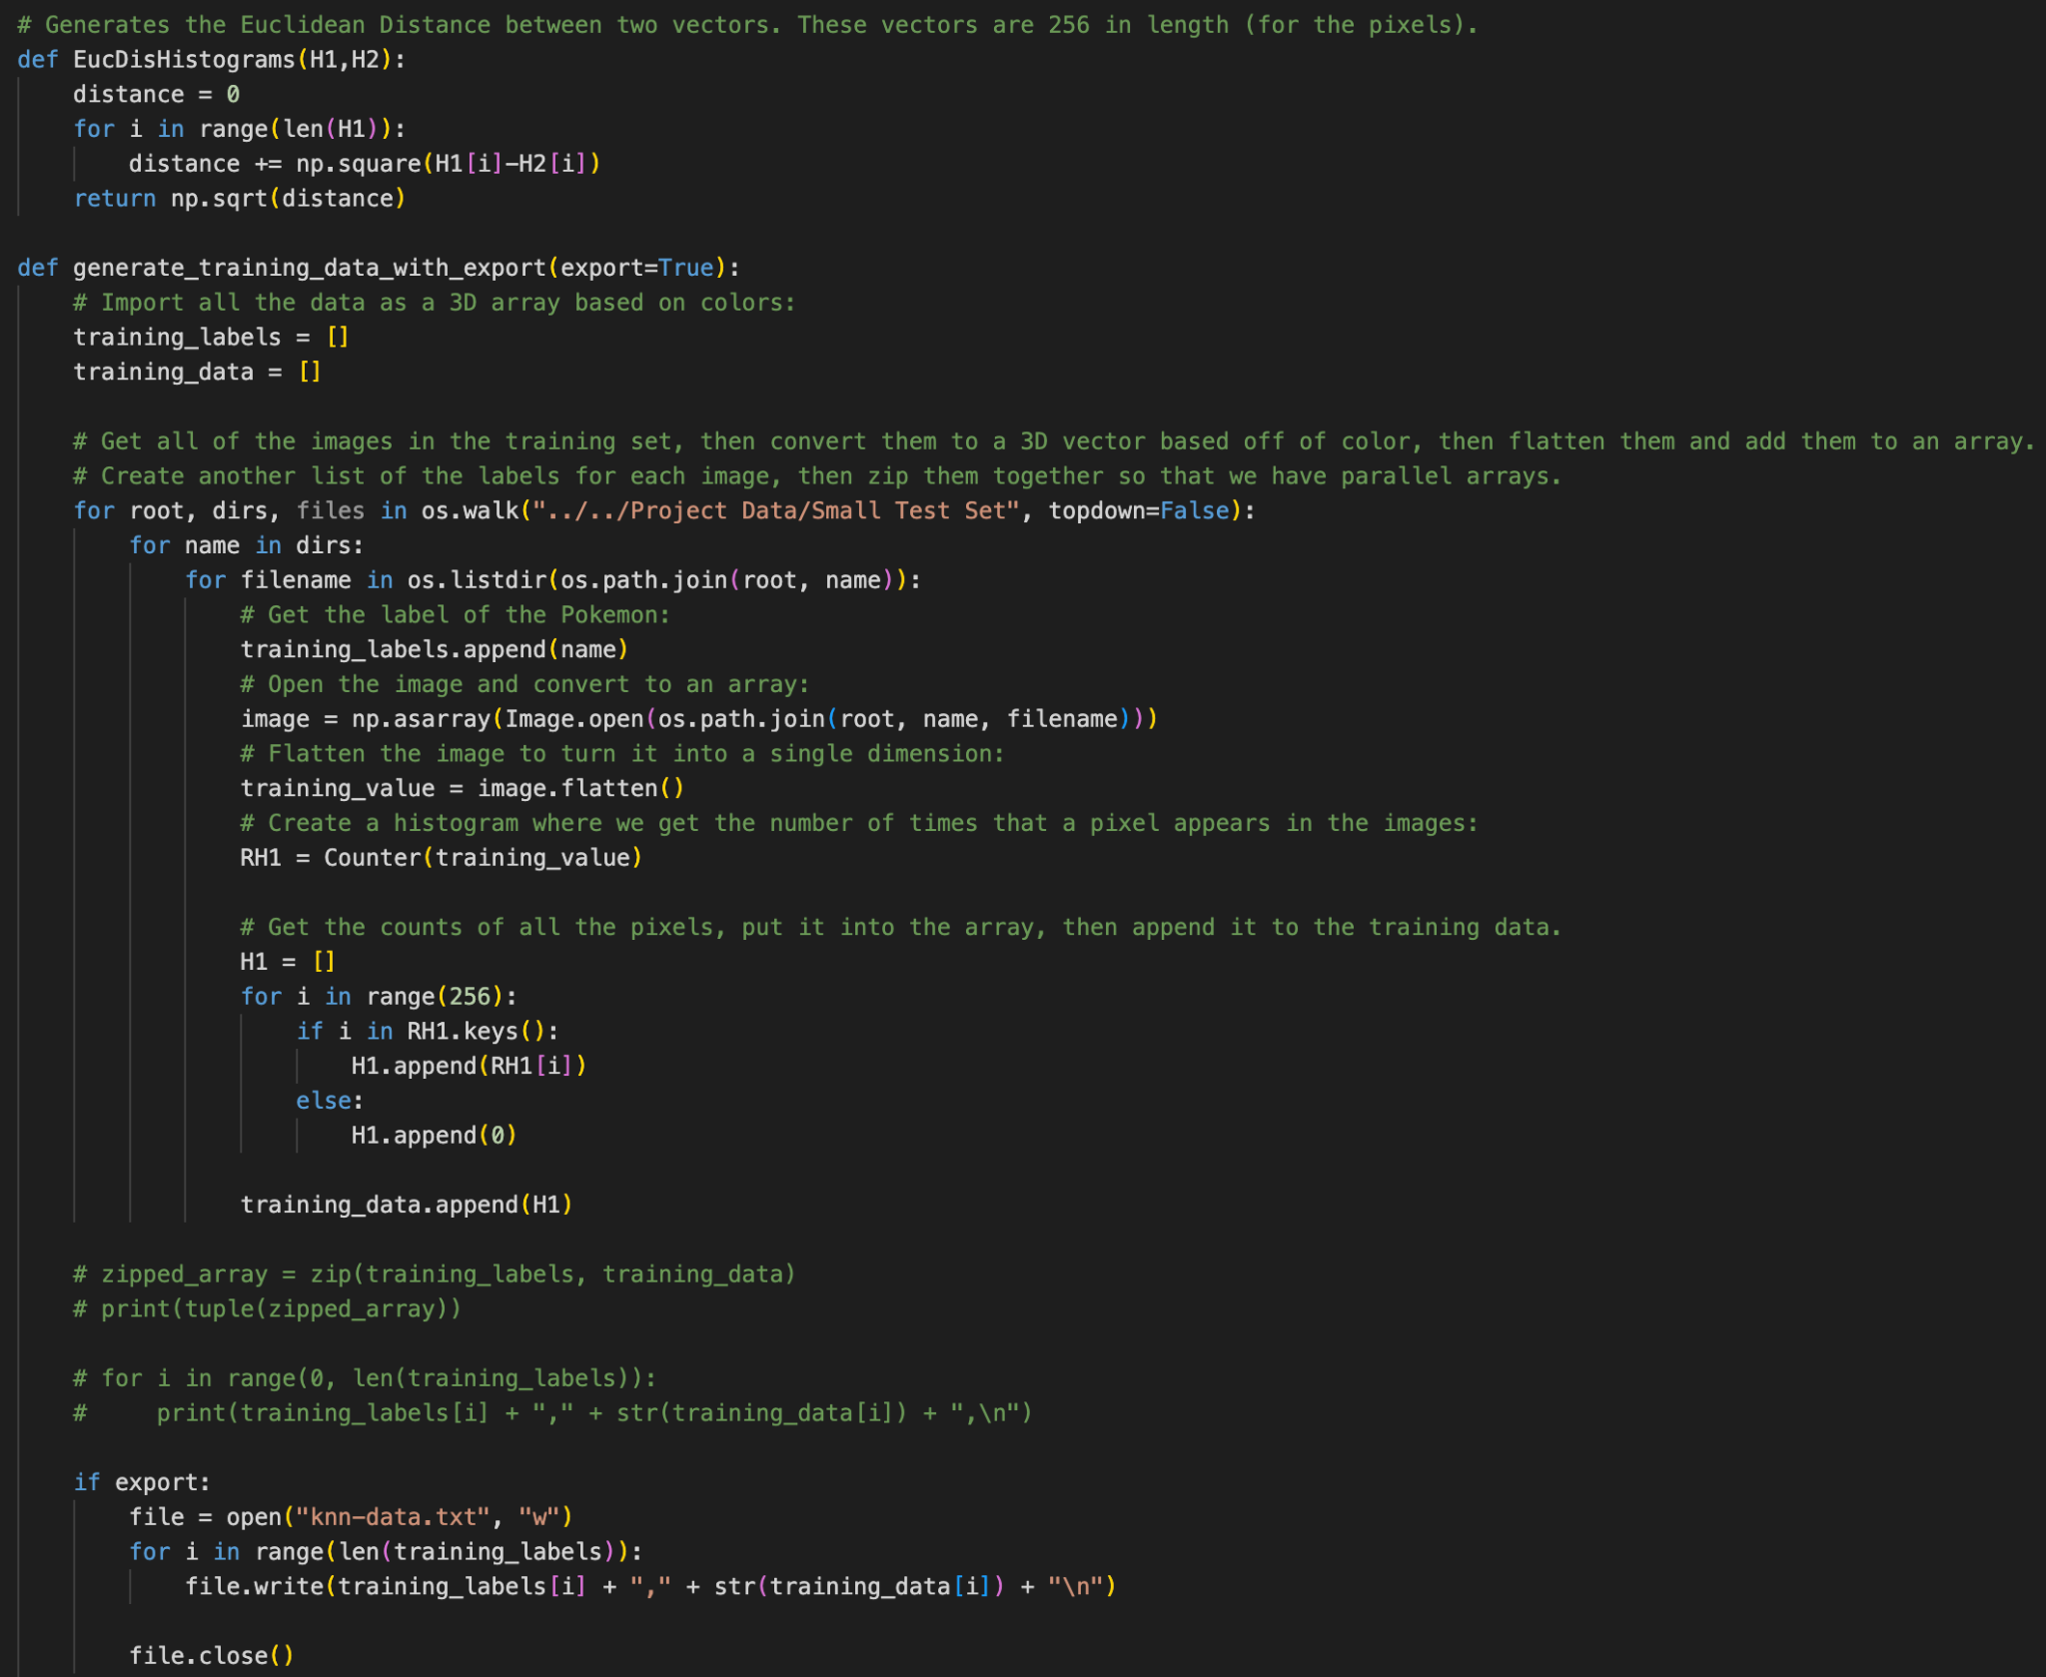
Code Overview (K-NN) - Part 1
Notes:
k=4

Slide 21
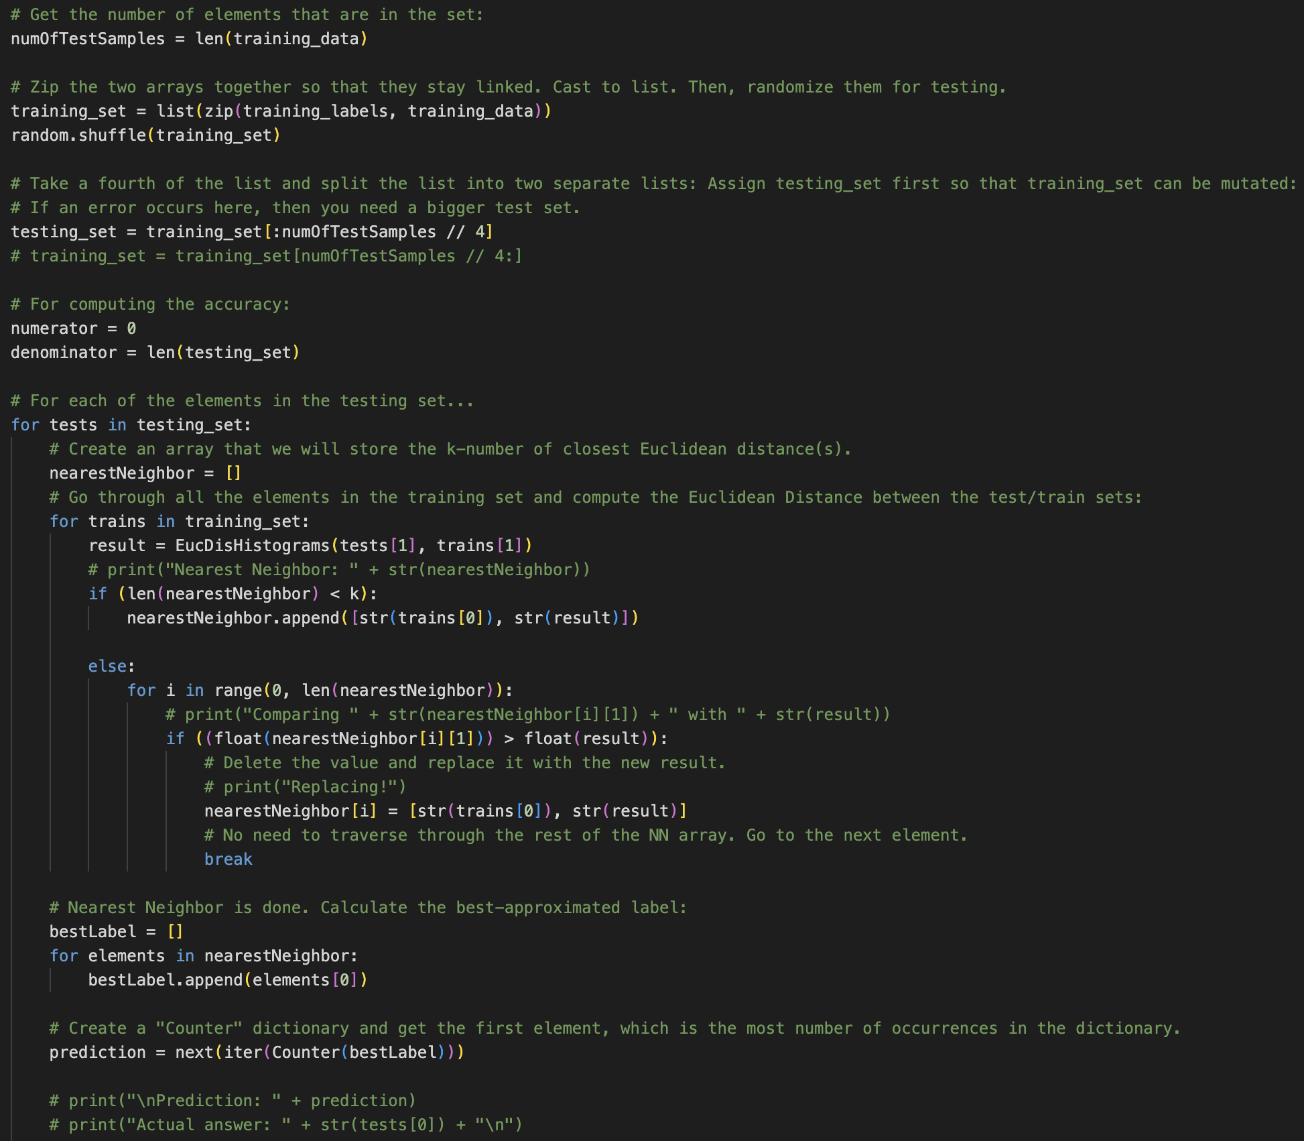
Code Overview (K-NN) - Part 2

Slide 22
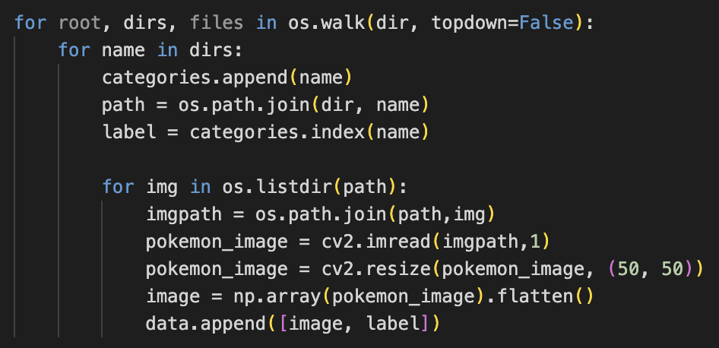
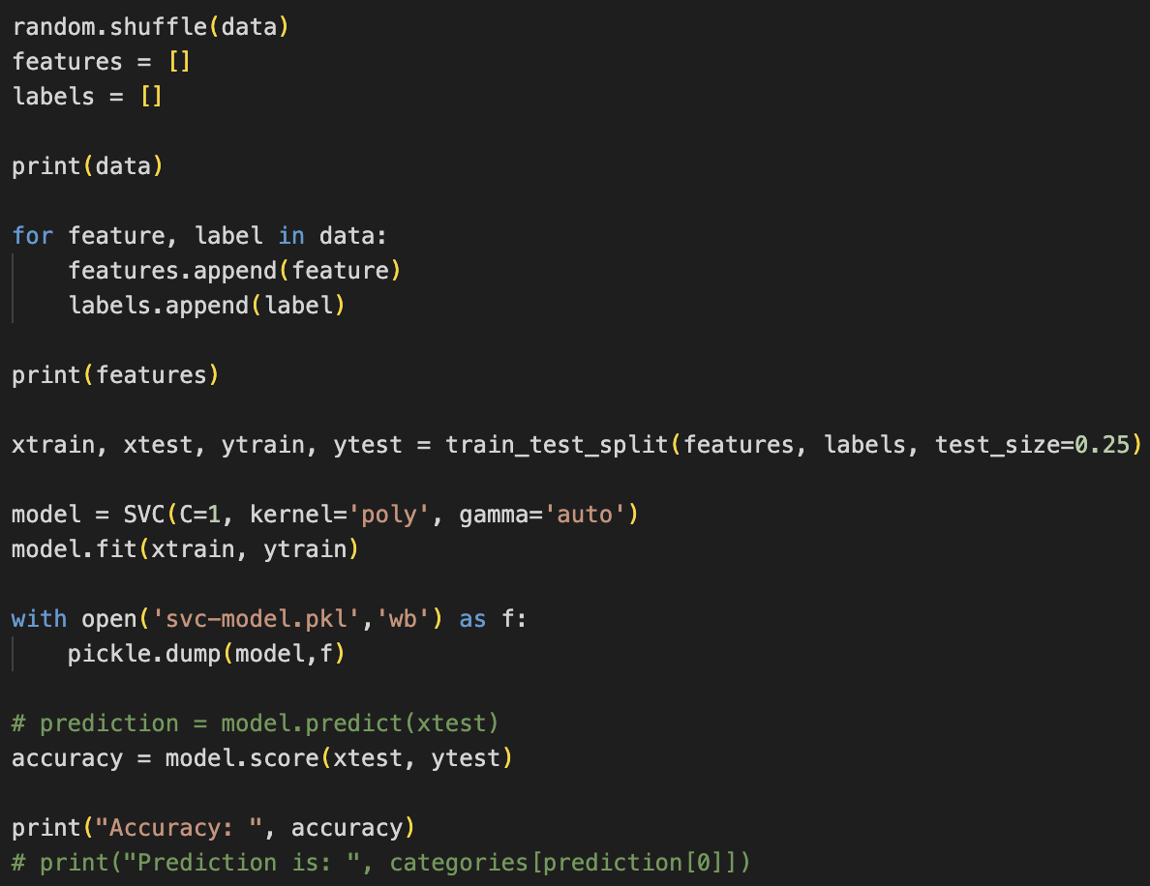
Code Overview (SVM)

Slide 23

Demonstration
Due to restrictions from online web hosts, we will be demonstrating on a local web server.
The website can be viewed on www.pokemonimagerecognition.com. However, the live domain is not functional due to RAM and CPU restrictions.
Can also be found by Googling “pokemon image recognition”.
Source: https://www.pinterest.com/pin/742953269760209829/

Slide 24
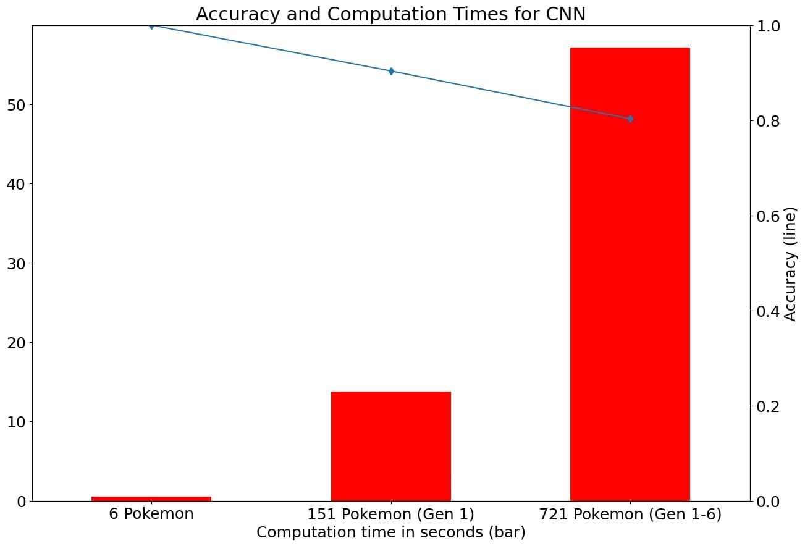
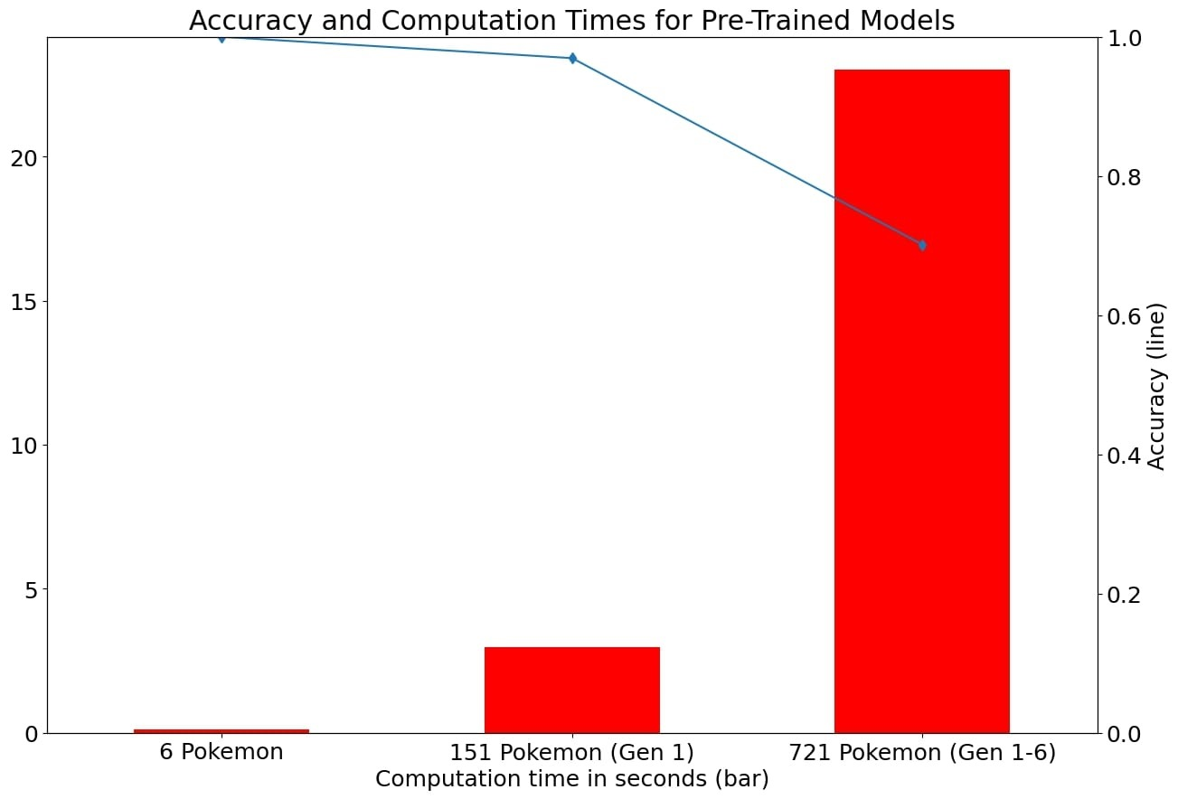
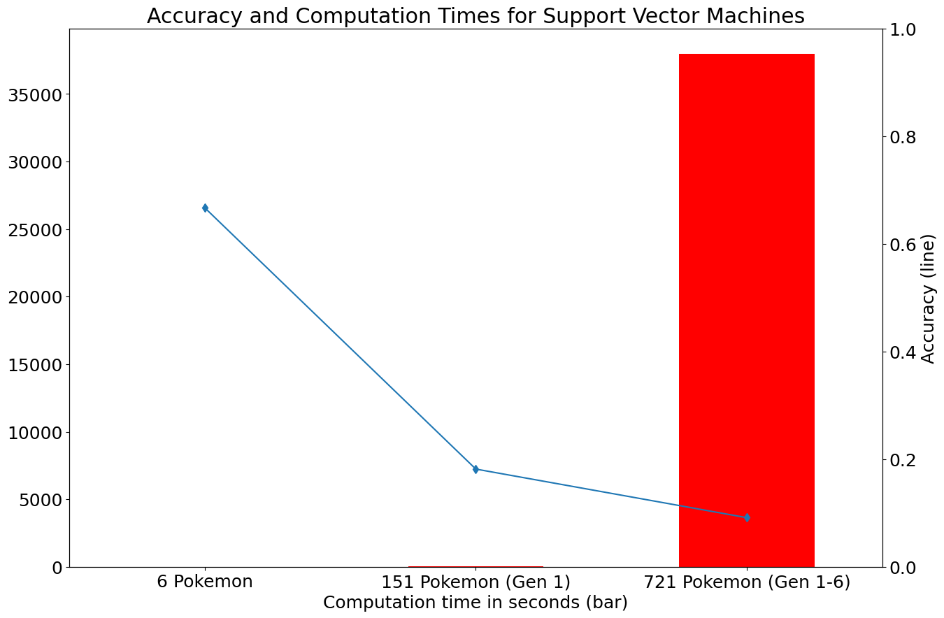
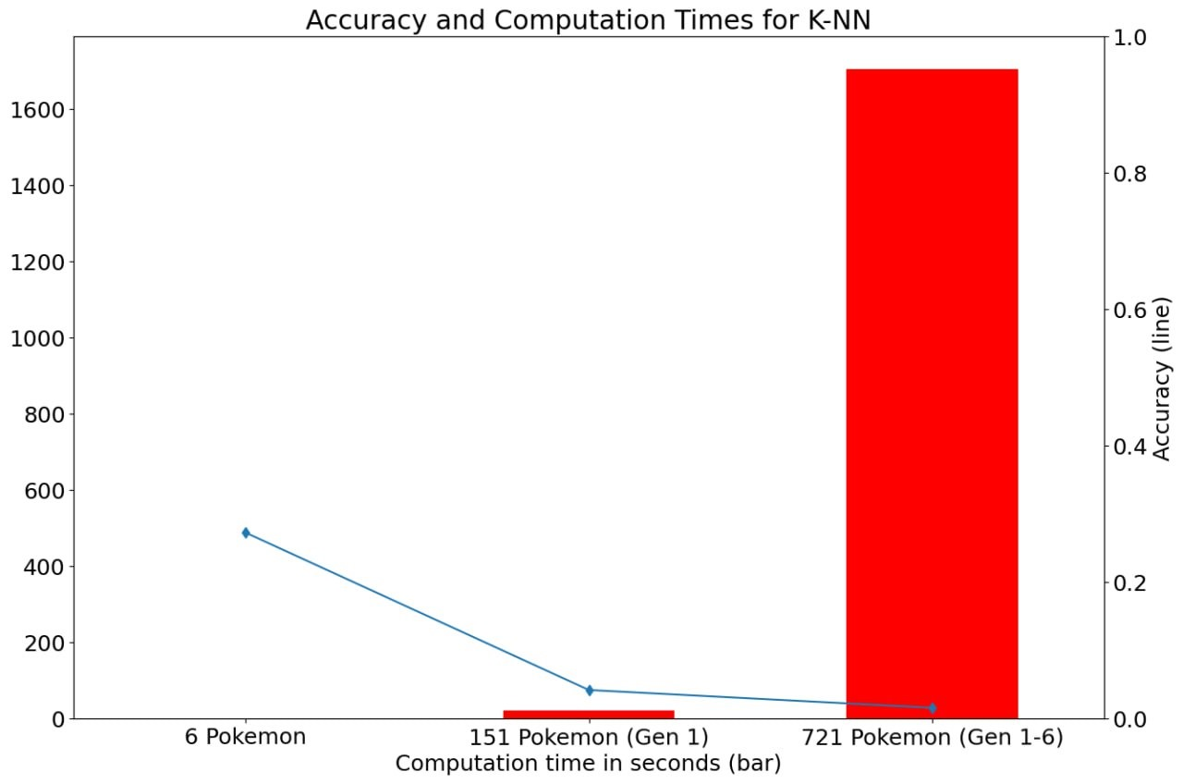
Results

Slide 25
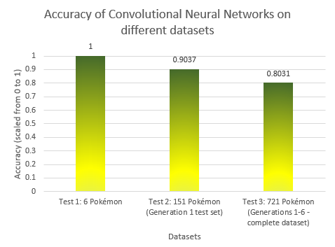
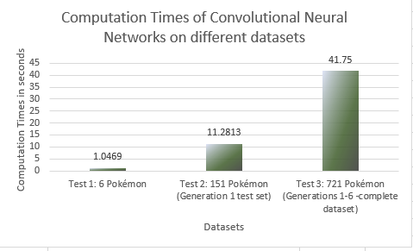
RESULTS FOR CONVOLUTIONAL NEURAL NETWORKS

Slide 26
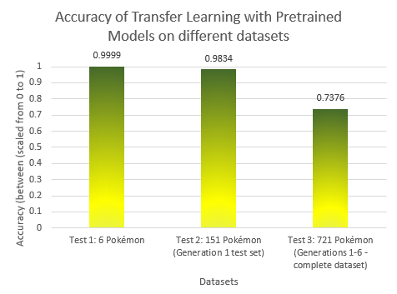
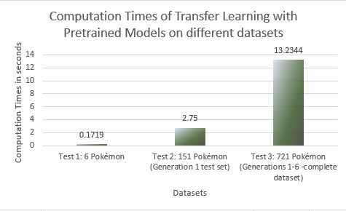
RESULTS FOR TRANSFER LEARNING WITH PRETRAINED MODELS

Slide 27
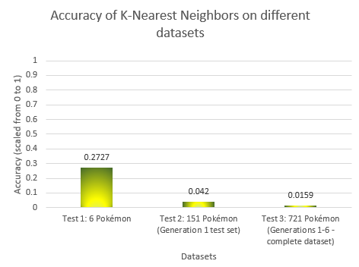
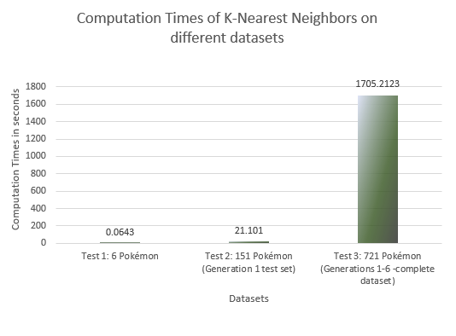
RESULTS FOR K NEAREST NEIGHBORS

Slide 28
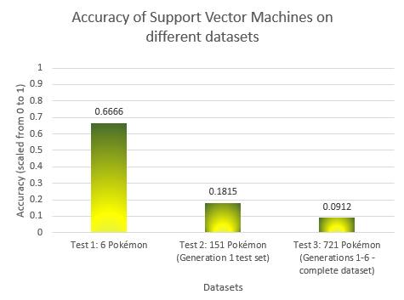
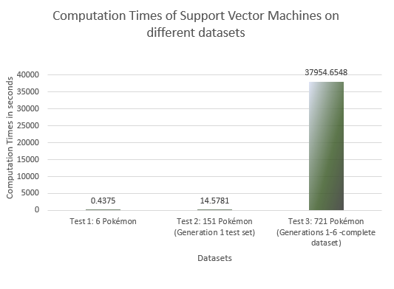
RESULTS FOR SUPPORT VECTOR MACHINES

Slide 29
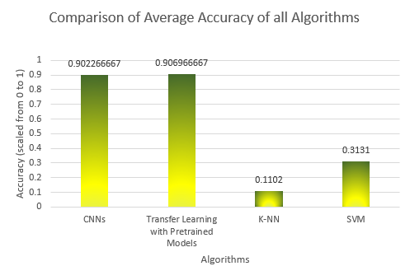
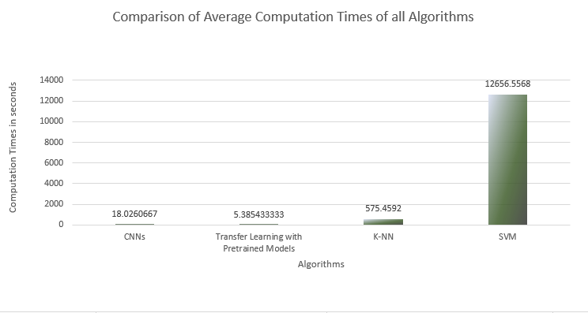
COMPARISON OF PERFORMANCE OF ALL ALGORITHMS

Slide 30
Conclusions
Average accuracy and computation time for each algorithm
Transfer Learning with Pretrained Models (90.6% and ~5.4 seconds)
Convolutional Neural Network (90.2% and ~18.02 seconds)
Support Vector Machines ( 31.31% and ~12656.56 seconds)
K-Nearest Neighbor (11.02% and ~575.49 seconds)
Transfer Learning with Pretrained Models (CNN as Pretrained Model as well as New Classifier) performed the best on both metrics, computation time and accuracy.
CNN’s results were very similar to Transfer Learning on the metric of accuracy, but took longer computation times.
SVM and K-NN took immensely long to execute as well as provided much poorer performance compared to the Transfer Learning and CNN models because they are not suited for image recognition. They are not good at processing image data, especially large tensors.
Curse of dimensionality was a problem with K-NN.
The performance of SVM shows that it is much less suited to large datasets with a large number of classes compared to the other three algorithms.

Slide 31
Questions?

